Slide 1
Global Data Science Challenge 2
Daniel
Predict lead time of IT service requests
Daniel Kühlwein, Gautam Kar, Tom Kochuyt

Slide 2
Agenda
01
Daniel
Challenge use case
02
What is lead time?
03
Context of the dataset
04
Challenge timeline
05
Challenge rules
06
Submission and evaluation
2
Notes:
Este slide eles acham que esta muito apertado.
Mudar o estilo do texto do lado esquerdo para diferencia-lo do texto do lado direito. Menos texto e mais impactante “short introduction”. Coloccar este texto do lado esquerdo da mesma cor da forma e o fundo do dlide claro.

Slide 3
Challenge use case
Tom
Being able to tell a customer, at the moment he/she raises a new IT service request, how long he/she will have to wait for the request to be completed by the IT team (aka the request lead time), is a big step towards improving customer satisfaction.
The client previously tried to predict the lead time through hand-crafted predictions models but was not very successful. The problem was found to be too complex with various, partially unknown, factors affecting the results.
With AI being all over the news, the client is willing to give this problem another shot and hired your team to solve it. He provided you with historical request data of several hundred service requests.
Use Case
Predict the Lead Time for all open IT service requests. The team with the lowest root mean square log error (RMSLE) between the lead time prediction and the actual lead time wins.
Task

Slide 4
What is Lead Time?
Tom
Customer
Demand
(request service, open incident, raise change request, …)
Throughput
(service delivered, incident resolved, change deployed, …)
Demand Fulfilment
(deliver service, resolve incident, create & deploy change, …)
Customer perspective
The time a customer is waiting for delivery of what was ‘requested’
Lead Time
Provider perspective
The total time a ‘request to work on’ is in the fulfillment process

Slide 5
A bit of context…
Tom
All IT service request are recorded in the IT Service Management tool as ‘work items’
Work items are created by ‘business’ (a business application owner or a user of the application).
The creator of a work item defines the type of work requested, the priority of the work, the business domain, business application (and related components) for which the request is created. These values cannot be updated after creation.
Fulfillment of a service request happens in phases, executed by members of the IT team
Each phase represents a specific type of activity to be executed or coordinated by a member of the IT team.
The ‘logical’ sequence of phases is ‘Analyze’, ‘Clarify’, ‘Design’, ‘Build’, ‘Test’, ‘Package’, ‘Accept’ and ‘Deploy’.
Newly created work items are automatically assigned
to the phase ‘Analyze’,
to a member of the IT team based on the business domain & application.
Work items are transferred from phase to phase and resource to resource as work progresses
Each such transfer is recorded in the ITSM tool.
Work items do not have to pass through all phases in sequence, as such a work item can both
skip forward, e.g. move from phase ‘Analyze’ directly to phase ‘Build’,
move backward, e.g. move from phase ‘Test’ back to phase ‘Build’.
Completion of a work item is recorded in the IT Service Management tool
Work items cannot be ‘re-opened’. In case of issues after completion of a work item, a new work item will be created.

Slide 6
Some examples
Tom
A closed work item which followed the logical end-2-end sequence of phases
An open work item with some rework

Slide 7
Dataset and data attributes
Tom
The dataset is a (time-ordered) log of all work item events, for each event a line with following attributes is recorded
Attribute | Description
timestamp | Date and time of the event, format is dd.mm.yyyy hh:mm:ss
work_item | Unique identification of a work item, alphanumerical values
work_type | Type of work requested, alphanumerical values from WT_00001 to WT_00003
work_priority | Priority or urgency of work requested, alphanumerical values from WP_00001 to WP_00005
domain | Business domain for which the work is requested, alphanumerical values
platform | Application/technology platform for which the work is requested, alphanumerical values
components | List of related (technical) components, alphanumerical values separated by ‘/’
from_phase | Phase the work item has left, this attribute is ‘empty’ (null) for newly created work items
to_phase | Phase the work item is transferred to, this attribute is ‘empty’ (null) for items that are completed
from_resource | Member of the IT team that was assigned to the work item
to_resource | Member of the IT team that is assigned to the work item

Slide 8
Challenge timeline
Gautam
Global Data Science Challenge II kick off on 15-March-2019 (today)
Registration
Q&A Sessions
Final Submission
Evaluation
Please register yourself or as a team in the following link
http://10.41.72.110:8000/
Last Date of Registration:
01-May-2019
We will organized three Q & A sessions for your question and give initial help of building the model. These sessions are planned on –
22-Mar-2019
29-Mar-2019
05-Apr-2019
Your prediction needs to be uploaded in the following link http://10.41.72.110:8000/
Last Date of Submission:
03-May-2019
Final evaluation and Winner announcement will be on
17-May-2019

Slide 9
Challenge rules
Gautam
Data:
Data used in this competition is for Capgemini internal use only and may not be shared with external parties.
Data may not be stored on locations outside of the Capgemini perimeter (e.g. cloud-based storage, customer provided infrastructure, …).
Competition participants are responsible for proper use of the data and ensuring confidentiality of the data.
Any kind of external data can be used to improve the model performance.
Tools and infrastructure:
Participants are requested to use Capgemini infrastructure for this competition.
Participants can use any language or framework for this challenge.
Teams:
Organizer team will publish team name in ‘Teams’ link of the challenge website.
Participants are allowed to join alone or in a team (maximum of 4 members).
Participants joining alone can also form team with other participants. Last date of forming the team is 01-May-2019.
Evaluation:
The best test submission will be taken into account for final evaluation.
Jury decision on the evaluation is final.

Slide 10
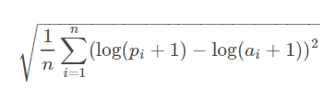

Submission & evaluation of your predictions
Gautam
Submitting your predictions:
A prediction must be made for all work items in the dataset for which no completion event has been recorded.
The submission file must contain two columns
work_item containing the unique identification of the work item for which you are predicting the lead time.
lead_time containing the (calendar) days since creation of the work item, expressed as a positive float.
The submission file must be provided as a single comma-separated file, containing
A header line with the column names
One line per work item to be predicted
Evaluation method:
Submissions are evaluated on the Root Mean Squared Logarithmic Error (RMSLE), which is calculated as
Submission not containing all the work items to be predicted will not be considered for evaluation
is the number of work items to be predicted
where
is your predicted lead time
is your actual lead time

Slide 11
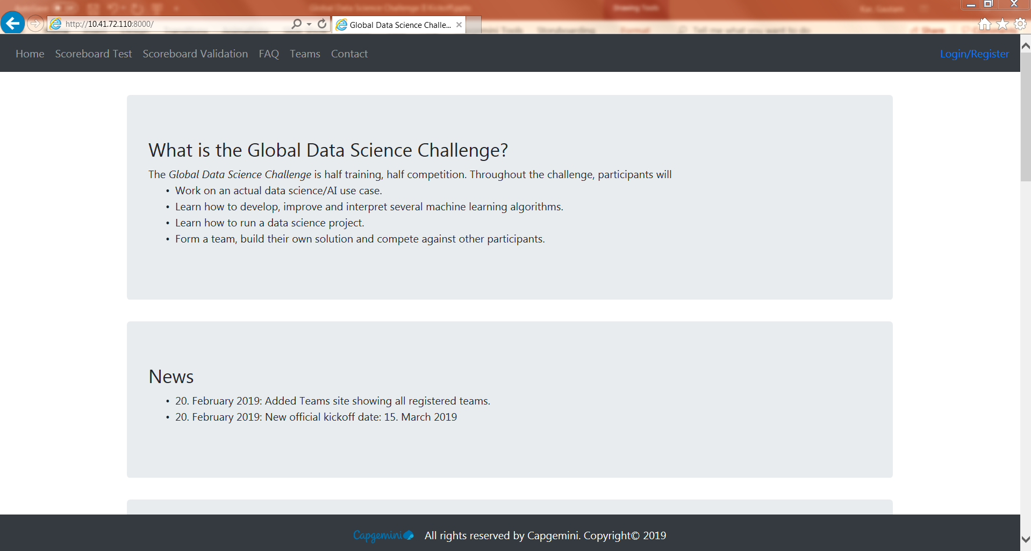
Submission & evaluation of your code & model
Daniel
Data Science Challenge website Demo

